Slide 1
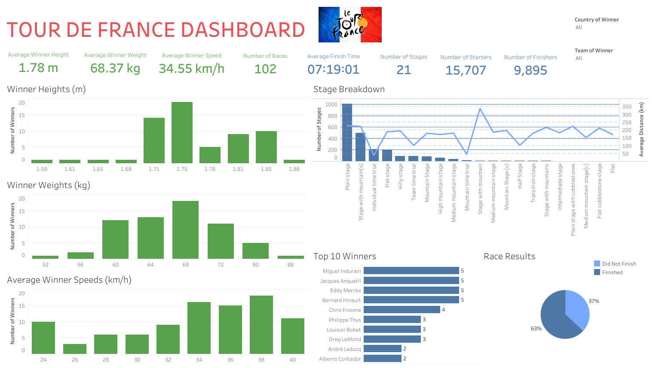

Slide 2
Abstract
I assumed the role of a data visualization expert at the Amaury Sport Organization
This company organizes the annual Tour de France cycling race.
My goal is to increase the race’s popularity around the world by creating an infographic-style visual that will do the following:
Educate new viewers
Highlight the magnitude of the event
Build anticipation for this year’s race
To accomplish this goal, I created an exploratory dashboard that summarizes key insights into a historic dataset for every Tour de France from 1903-2022.
The dashboard is interactive
The user can filter out the country and teams of each Tour de France winner

Slide 3
Data Cleaning Strategy
The dataset was a combination of structured and unstructured data.
Therefore, my data cleaning strategy was a little bit involved.
This was how I cleaned the “tdf_finishers” table:
Split the Country and the Rider into two separate columns.
Changed the Time values to duration arrays.
This was how I cleaned the “tdf_stages” table:
Removed the imperial values for the distances.
Split the Country and Winner into two separate columns.
Split the Starting and Ending Cities of the Courses into two separate Columns.
This was how I cleaned the “tdf_tours” table:
Removed the imperial values for the distances.
Combined Starters and Finishers into one column.
This was how I cleaned the “tdf_winners” table:
Converted Time values to duration arrays.
Removed the units from the Height, Weight, and Avg Speed and converted the values to numeric data types.
I placed the units for each metric in their corresponding column name.

Slide 4
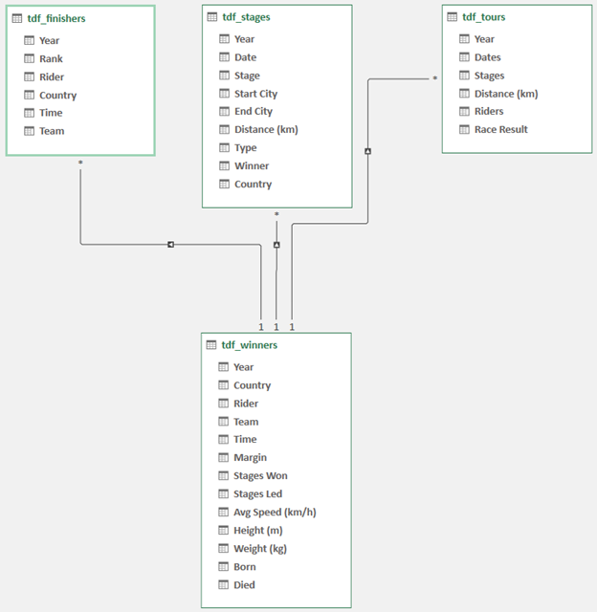
Data Model

Slide 5
Insights
Here are the following insights into the Tour de France Winners:
Most frequent winners:
Miguel Indurain (5 wins)
Jacques Anquetil (5 wins)
Eddy Merckx (5 wins)
Bernard Hinault (5 wins)
Most frequent winner height range: 1.75 - 1.78 m
Most frequent winner weight range: 68 – 72 kg
Most frequent winner average speed range: 38 – 40 km/h
Here are the following insights into the Tour de France:
Race completion rate: 63%
Most frequent stage: Plain Stage (1,008 stages)
Stage with the longest average distance: Stage With Mountain (337.8 km)

